Slide 1

Based on “Microsoft Word Training” by Baycon Group
http://www.baycongroup.com/word2007/01_word2007.html

Slide 2
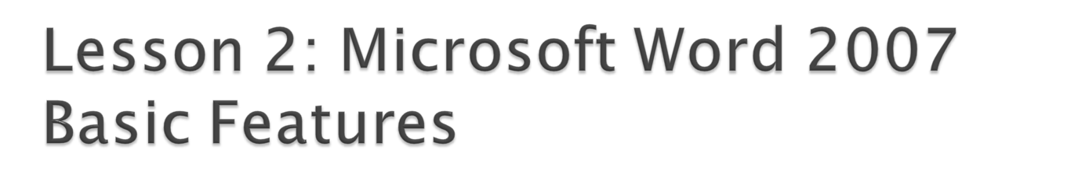
This lesson covers typing, using the Backspace key, using the Delete key, inserting text, bolding, underlining, and italicizing.

Slide 3

In Microsoft Word, you create documents by typing them.
  To create a report, open Microsoft Word and begin typing.
  When your text reaches the end of a line, Microsoft Word automatically moves your text to a new line.
  To start a new paragraph, press Enter.
    Microsoft word creates a blank line to indicate the start of a new paragraph.
  To capitalize, hold down the shift key while typing the letter you want to capitalize.

Slide 4

Deleting text
  You can use the Backspace key to delete.
    Each time you press the Backspace key, Microsoft Word deletes the character that precedes (is in front of) the insertion point.
    The insertion point is the point where your mouse pointer is located.
  You can also delete text by using the Delete key.
    Select the text you want to delete; then you press the Delete key.

Slide 5

To insert text—place new text between existing text.
  Suppose, you type the sentence, "Joe has a large boat." To change the sentence to "Joe has a large blue boat" with Microsoft Word, inserting a word, phrase, or even several paragraphs is easy.
To overtype text—replace old text with new text.
  For example, suppose you type the sentence, "Joe has a large blue boat." After typing it, changing the sentence to "Joe has a large gray boat" is gray is also easy.
Note: You can overtype text without changing to Overtype mode by selecting the text you want to overtype and then typing.

Slide 6

Before using insert or overtype, check the mode you are in—Insert or Overtype.
  Right-click the Status bar and use the Customize Status Bar menu to place the Insert/Overtype button on the Status bar.
  You can use the Insert/Overtype button to switch between Insert and Overtype mode.
  When you are in Insert mode, you can insert text. When you are in Overtype mode, you can overtype text. By default, Microsoft Word is in the Insert mode.

Slide 7

When creating a document, you may need to emphasize particular words or phrases by bolding, underlining, or italicizing.
Also, certain grammatical constructs require that you bold, underline, or italicize.
You can bold, underline, and italicize when using Word.
You also can combine these features—in other words, you can bold, underline, and italicize a single piece of text.

Slide 8

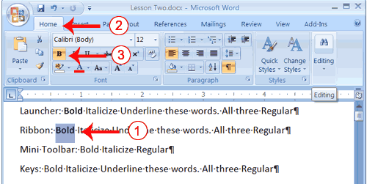
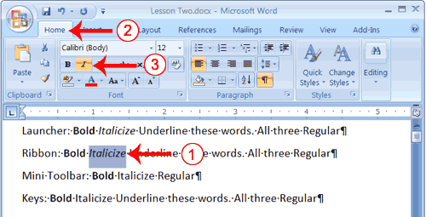
Bold with the Ribbon
Italicize with the Ribbon

Slide 9
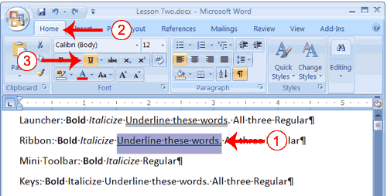
Underline with the Ribbon

